Slide 1
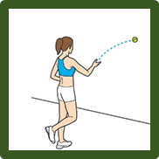
Personal challenge
Alternate Hand Throw
Equipment
Tennis Ball
Wall
Tape Measure and markers/cone
Clip board, pen and score sheets
Instructions
A marker/cone is placed 2 metres from the wall.
Thrower starts behind it.
The ball is thrown from one hand in an underarm action against the wall, and attempted to be caught with the opposite hand.
The ball is then thrown back against the wall and caught with the 1st hand.
This is timed for 30 seconds and the number of successful catches recorded.
KS1 – One Hand Throw – throw and catch with 2 hands

Slide 2
Personal challenge
Zig Zag Agility
Equipment
8 cones
4 tennis balls
Stop watch
Clip board, pen and score sheets
Instructions
Set up the course as shown in the diagram.
Cones are1m apart along sides and 2 m between the left and right hand cones.
Start and End cone 50cm beyond end line
Pupils must start with one foot by the start (green) cone .
On “go” they run the route as shown whilst moving tennis ball from one side to other
The timing finishes when they pass the finish (green) cone.

Slide 3
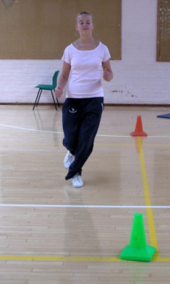
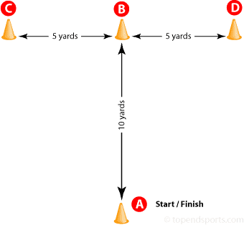
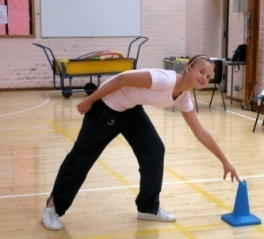
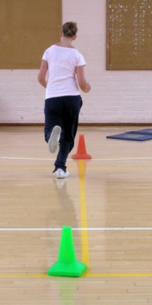
“T” drill test
Start at A
Run and touch B
Sidestep and touch C
Sidestep and touch D
Sidestep and touch B
Run back to A
HOW FAST CAN YOU DO THIS?
1 ATTEMPT
GOLD less than 5 seconds
SILVER less than 8 seconds
BRONZE less than 12 seconds
“T” JUNCTION OF BADMINTON COURT
4 CONES
STOPWATCH

Slide 4
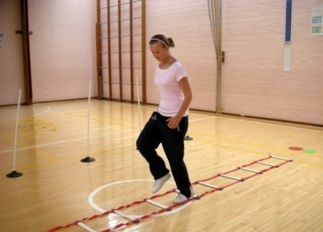
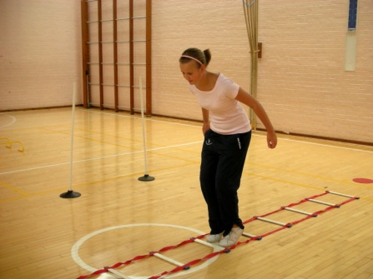
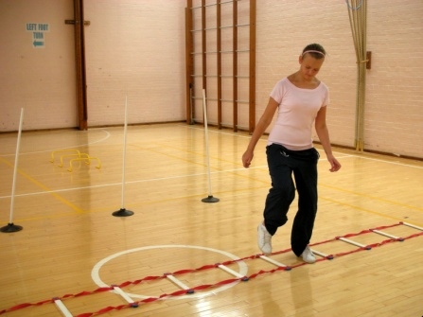
Ladder drill
1
1. Travel up the ladder putting one
foot inside each space
2. Run back to the start (next to ladder).
3. Travel up the ladder jumping two
footed into each space
4. Run back to the start (next to ladder)
5. Travel sideways up the ladder
putting each foot into all the
spaces
6. Run back to the start (next to the ladder).
HOW FAST CAN YOU DO THIS?
1 ATTEMPT
GOLD less than 15 seconds
SILVER less than 20 seconds
BRONZE less than 25 seconds
3
5
LARGE LADDER, RED & GREEN SPOT AT START/FINISH
STOPWATCH

Slide 5
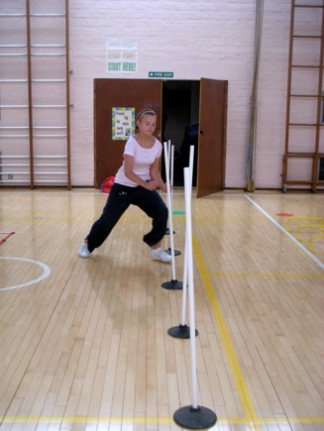
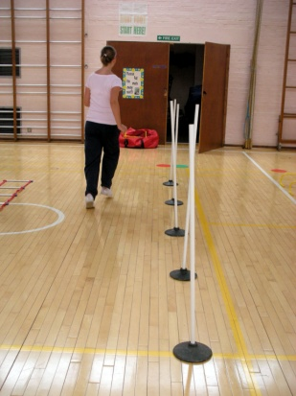
Slalom
Weave in and out of the poles.
Run back to the start.
Repeat
HOW MANY TIMES CAN YOU DO THIS IN 30 SECONDS?
1 ATTEMPT
GOLD 5
SILVER 4
BRONZE 3
5 POLES ACROSS WIDTH OF A BADMINTON COURT
RED & GREEN SPOT, STOPWATCH

Slide 6
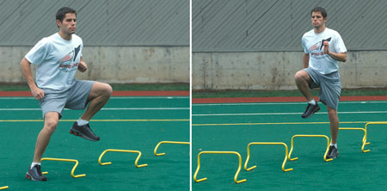
Mini hurdles drill
Run forwards over the 1st set of three hurdles
Sidestep over the 2nd set of three hurdles.
Run forwards over the 3rd set of three hurdles
HOW LONG DOES IT TAKE YOU TO DO 3
CIRCUITS WITHOUT ANY MISTAKES?
1 ATTEMPT
GOLD less than 16 seconds
AND no mistakes
SILVER less than 20 seconds
one mistake allowed
BRONZE less than 24 seconds
more than one mistake allowed
2
1
3
1
2
START &
FINISH
9 HURDLES, SET OUT AS 3 SETS OF 3. BETWEEN THE HURDLES IS THE LENGTH OF ONE HURDLE
RED & GREEN SPOT
STOPWATCH
3

Slide 7
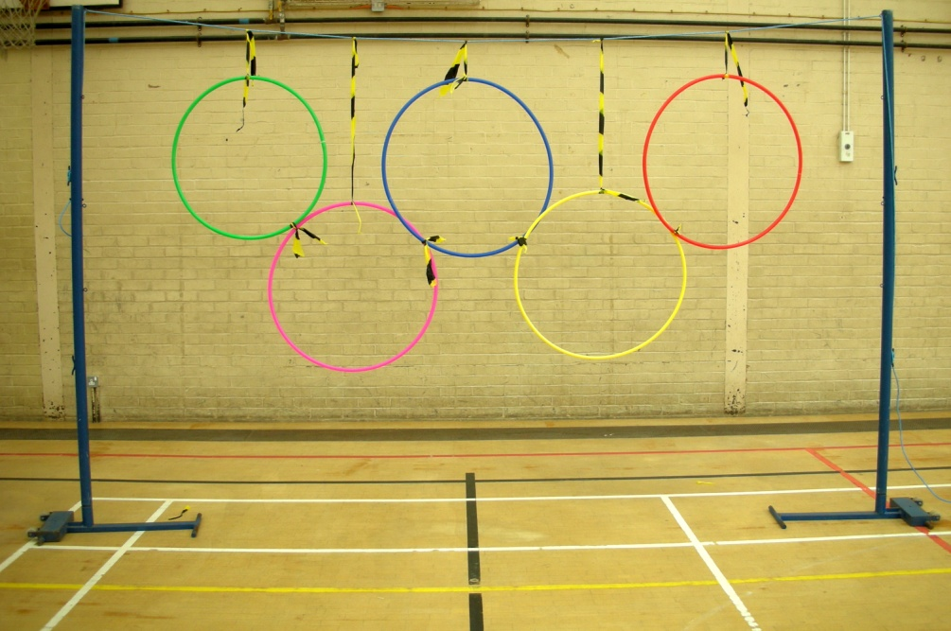
THE OLYMPIC RINGS
Start behind a line 4 metres from the rings.
You have to throw all 5 implements through separate hoops:
Sponge tennis ball
Large sponge ball
Sponge discus
Sponge javelin
Beanbag
1 ATTEMPT
GOLD 5
SILVER 4
BRONZE 3
5 HOOPS SUSPENDED FROM VOLLEYBALL NET HEIGHT

Slide 8
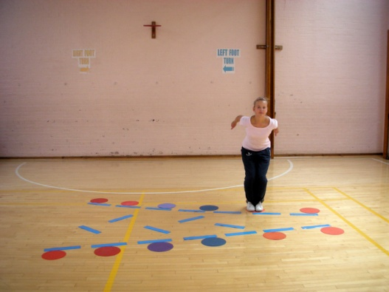
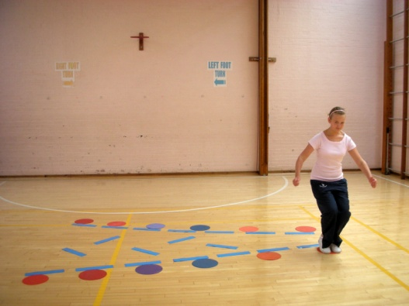
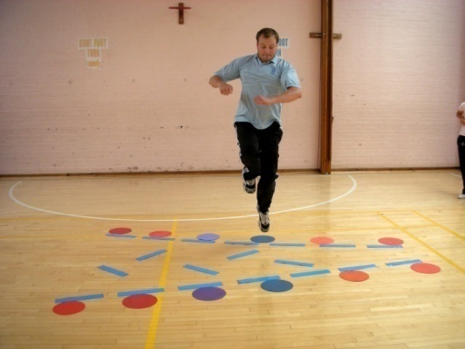
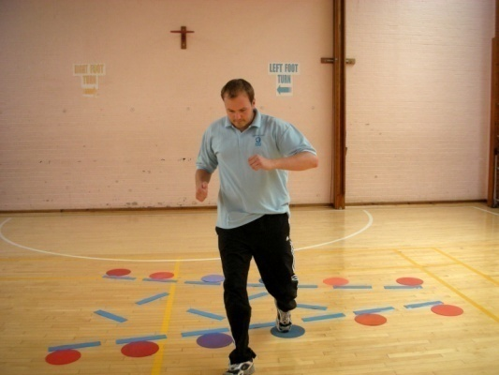
JUMP THE RIVER
Start on a spot and land on the spot across the river.
You can take off from 1 or 2 feet.
You can land on 1 or 2 feet.
You cannot touch the blue river with any part of your body.
HOW FAR CAN YOU JUMP?
3 ATTEMPTS – BEST ATTEMPT COUNTS
GOLD 150cm+
SILVER 100cm+
BRONZE 50cm+
1 or 2 foot take off 1 or 2 foot landing
SPOTS ARE 50CM, 75CM, 100CM, 125CM, 150CM AND 175CM APART.

Slide 9
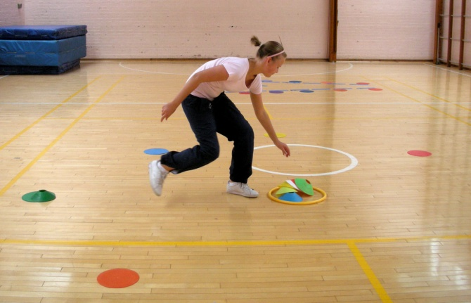
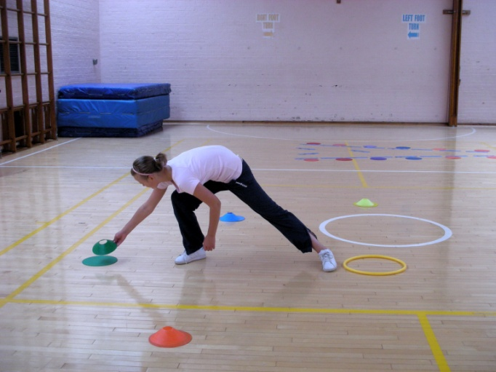
Matching cones to spots
Take one cone at a time from the hoop in the middle and place it on the same coloured spot.
Cones must be on the spot and not on the floor.
HOW LONG WILL THIS TAKE YOU TO DO?
1 ATTEMPT
GOLD less than 10 seconds
SILVER less than 15 seconds
BRONZE less than 20 seconds
8 DIMPLE CONES INSIDE A HOOP & 8 SPOTS 2M FROM THE HOOP

Slide 10

THROW &CATCH
Throw a ball against the rebound net AND catch it.
You can move to catch the ball, but must return behind the line before you throw again.
HOW MANY TIMES CAN YOU CATCH THE BALL IN 30 SECONDS?
1 ATTEMPT
GOLD 10
SILVER 7
BRONZE 4
3 metres
TCHOUKBALL GOAL AND SIZE 4 BALL
STOPWATCH

Slide 11
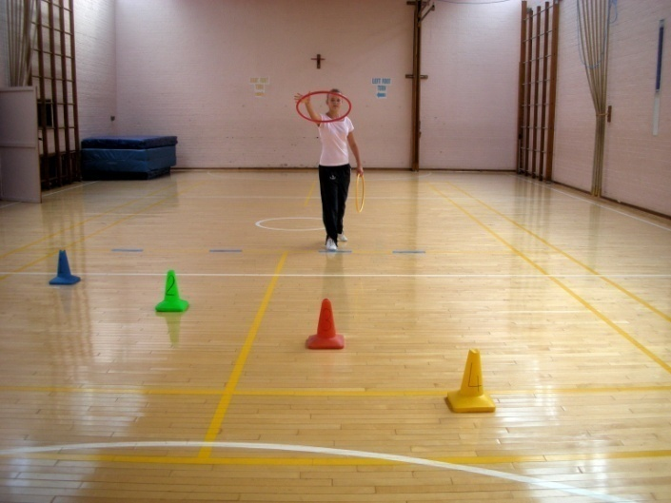
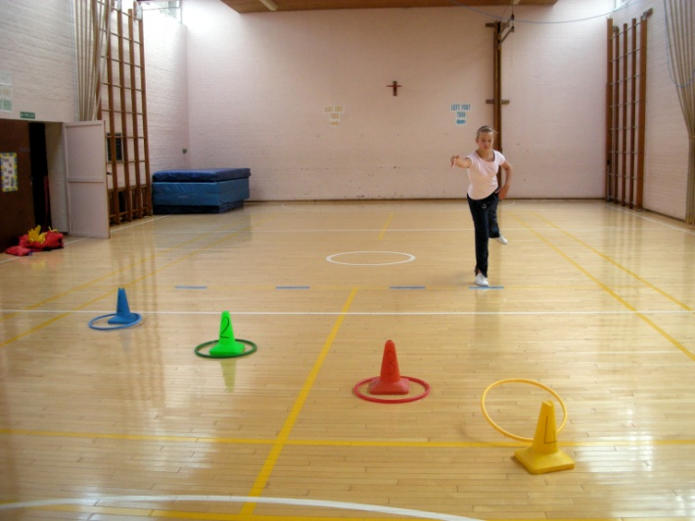
Hoopla
Stand behind the line and throw the hoops over the cones.
The 4 cones and 8 hoops are colour co-ordinated and you have to match them up.
The nearest cone scores 1 point and the furthest one away scores 4 points.
1 ATTEMPT
GOLD 18
SILVER 14
BRONZE 10
8 MINI HOOPS
(46CM)
4 CONES: -
1.4M FROM LINE
2.2M FROM LINE
3M FROM LINE
4M FROM LINE
4 LINES

Slide 12
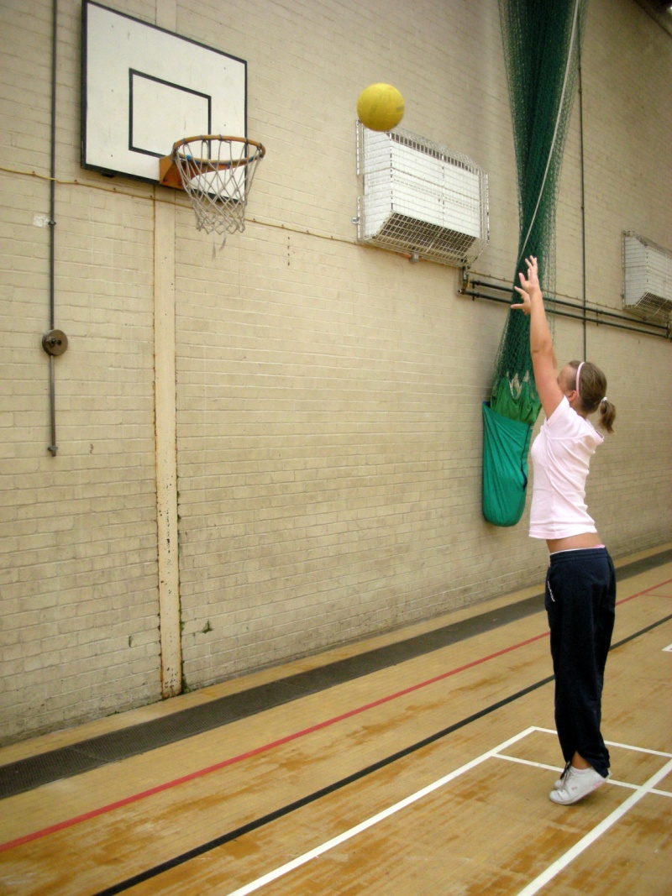
shooting
Stand behind the red line to shoot.
You can use the backboard.
HOW MANY GOALS CAN YOU SCORE IN 30 SECONDS?
1 ATTEMPT
GOLD 6
SILVER 4
BRONZE 2
SIZE 4 NETBALL
STOPWATCH

Slide 13
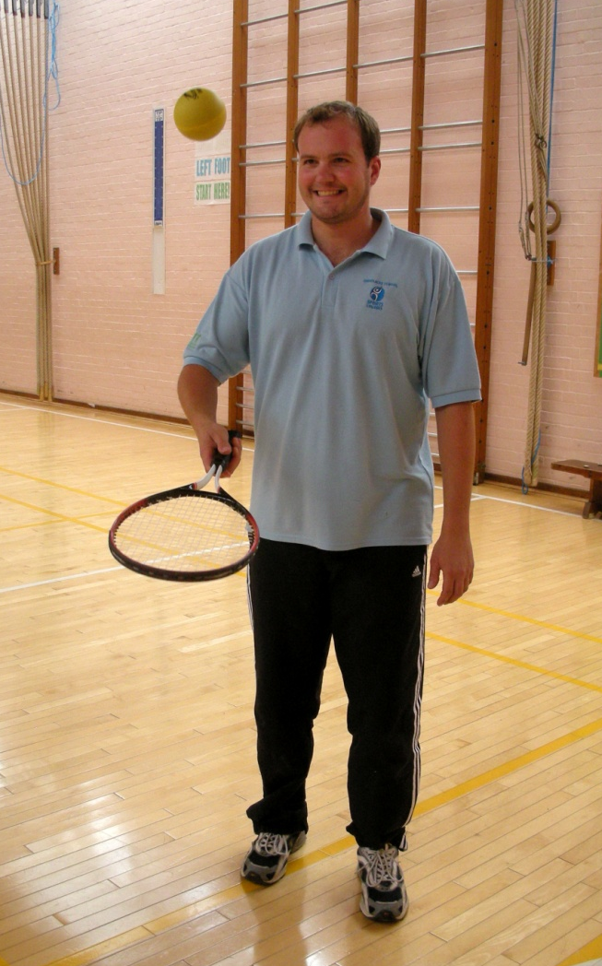
Bounce up
Bounce a sponge tennis ball in the air.
If the ball touches the floor or you stop bouncing, you have to start counting again.
HOW MANY BOUNCES CAN YOU DO IN 30 SECONDS?
1 ATTEMPT
GOLD 30+
SILVER 20+
BRONZE 10+
RACKET AND SPONGE BALL
STOPWATCH

Slide 14
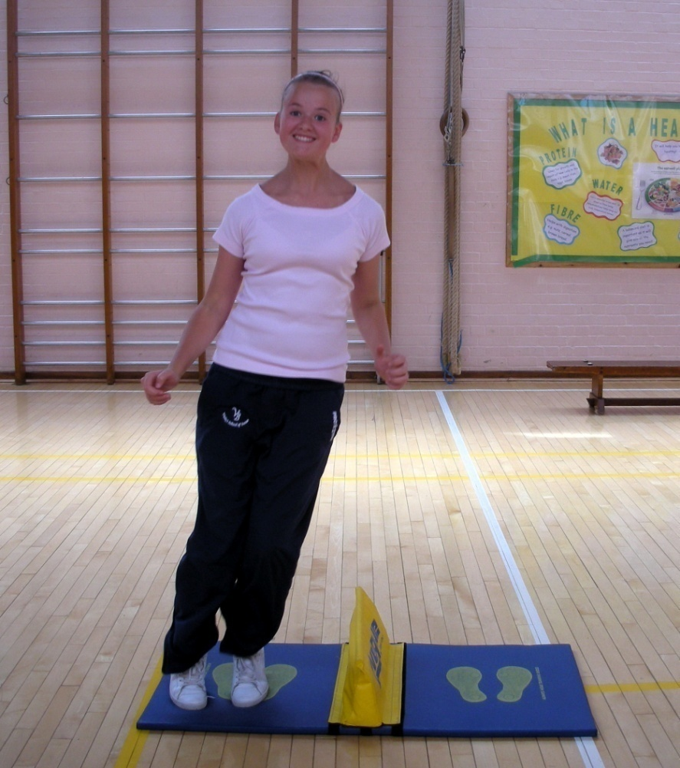
Speed bounce
Jump from one side of the barrier to the other.
HOW MANY TIMES CAN YOU JUMP FROM ONE SIDE TO THE OTHER IN 30 SECONDS?
1 ATTEMPT
GOLD 50+
SILVER 40+
BRONZE 30+
SPEED BOUNCE MAT AND BARRIER
STOPWATCH

Slide 15
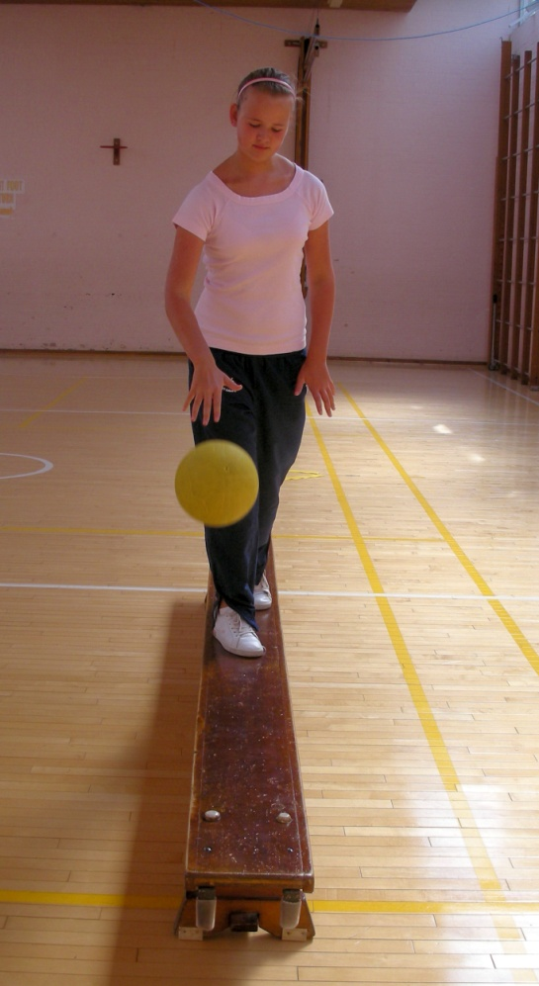
Bouncing ball on bench
Stand on the bench.
Bounce the ball 5 times as you walk along the bench.
Run with the ball back to the start.
Go back to the start if you make a mistake.
HOW MANY TIMES CAN YOU DO THIS IN 30 SECONDS?
1 ATTEMPT
GOLD 5
SILVER 4
BRONZE 3
BENCH, NETBALL
STOPWATCH

Slide 16
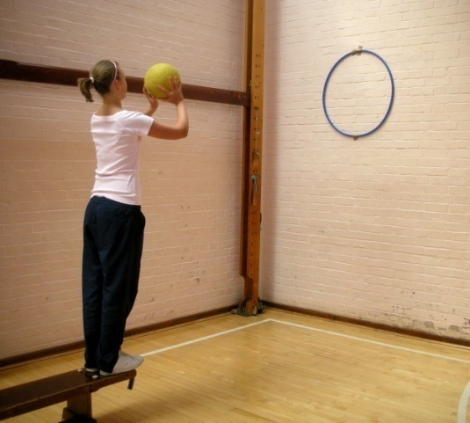
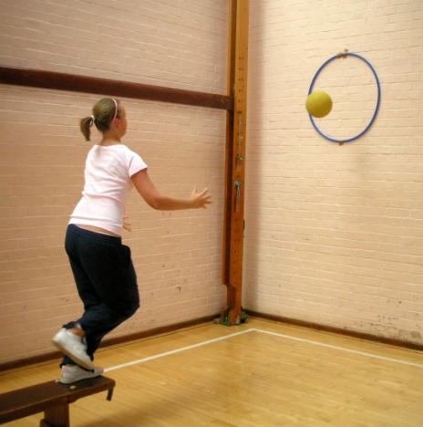
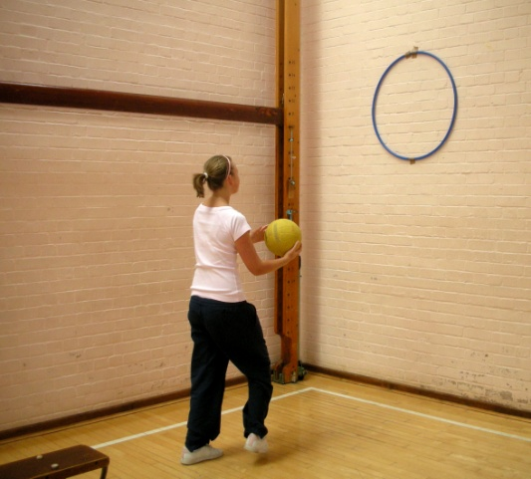
Jump & catch
Stand on the end of a bench and throw the ball into the marked area on the wall.
Jump off the bench to catch the ball whilst you and the ball are in the air.
HOW MANY CATCHES CAN YOU GET IN 30 SECONDS?
1 ATTEMPT
GOLD 6
SILVER 5
BRONZE 4
BENCH, NETBALL, HOOP
STOPWATCH

Slide 17
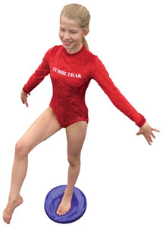

STORK balance
Stand on one leg on the balance disc.
The foot that is in the air can touch or be in front of the knee of the standing leg.
HOW LONG CAN YOU BALANCE FOR WITHOUT PUTTING YOU FOOT DOWN?
TIME LIMIT: 30SECONDS
1 ATTEMPT
GOLD foot stays in air
SILVER 1 contact with disc/floor
BRONZE 2+contacts with disc/floor
BALANCE DISC
STOP WATCH

